Slide 1

ENGINEERING CHEMISTRY
Asha A
Department of Science and Humanities

Slide 2

ENGINEERING CHEMISTRY
Module 3- Phase equilibria
Class content:
Gibb’s Phase rule
Derivation of Gibb’s Phase rule
Phase diagram of a 1-component system

Slide 3
ENGINEERING CHEMISTRY
Module 3- Phase equilibria
Phase rule
It was given by Williams Gibbs in 1874
Statement of Gibb’s phase rule
Provided the equilibrium in a heterogeneous system is not influenced by external forces (gravity, electrical or magnetic forces ), the number of degrees of freedom (F) of the system is related to number of components (C) and number of phases (P) existing at equilibrium to one another by the equation
F = C – P + 2

Slide 4
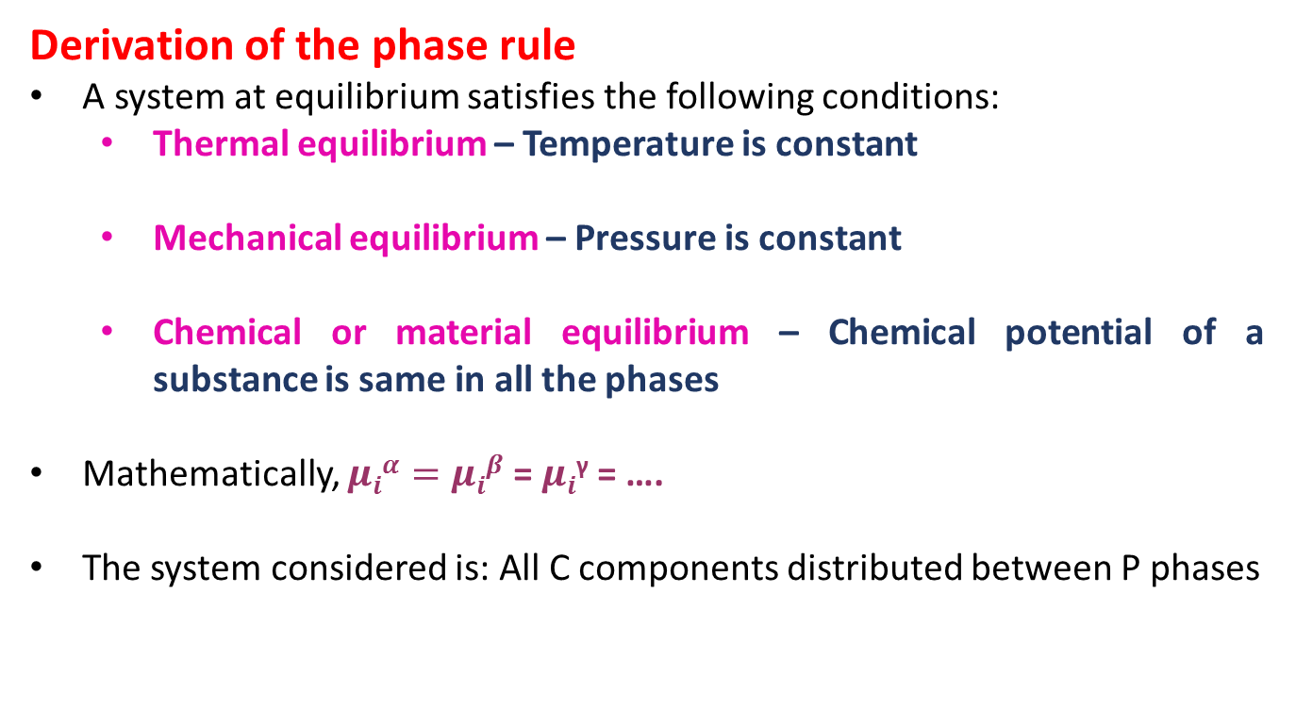
ENGINEERING CHEMISTRY
Module 3- Phase equilibria
Derivation of the phase rule
A system at equilibrium satisfies the following conditions:
Thermal equilibrium – Temperature is constant
Mechanical equilibrium – Pressure is constant
Chemical or material equilibrium – Chemical potential of a substance is same in all the phases
Mathematically, $μiα=μiβ$ = $μi$^{γ} = ….
The system considered is: All C components distributed between P phases

Slide 5
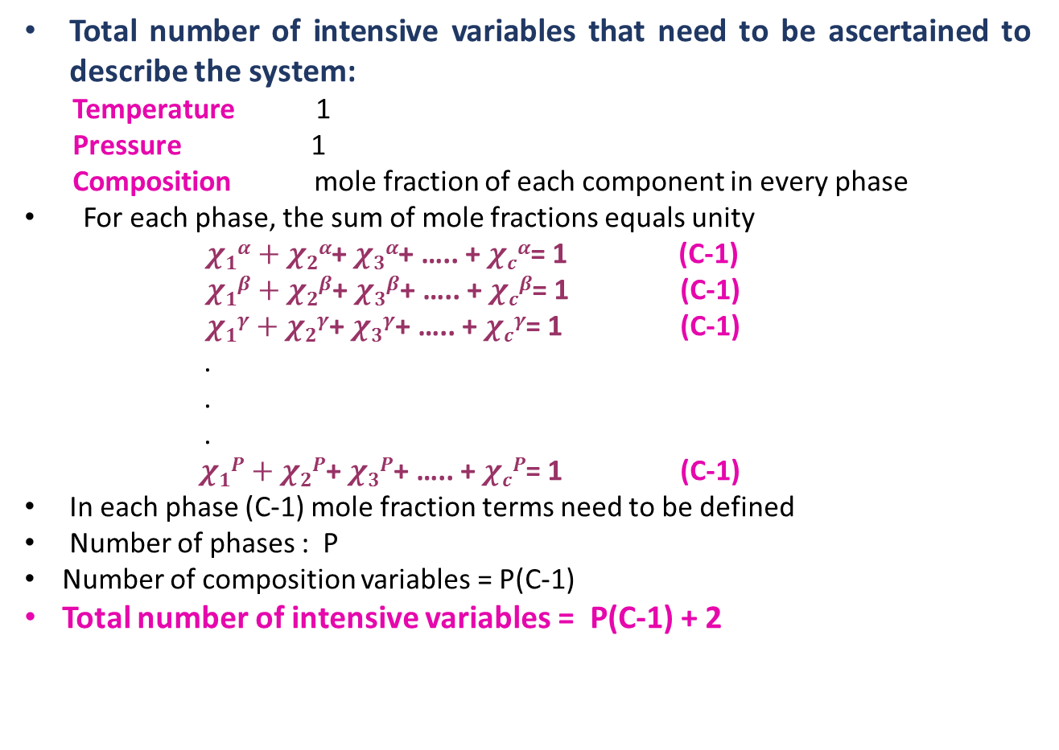
ENGINEERING CHEMISTRY
Module 3- Phase equilibria
Total number of intensive variables that need to be ascertained to describe the system:
Temperature 1
Pressure 1
Composition mole fraction of each component in every phase
For each phase, the sum of mole fractions equals unity
$χ1α+χ2α$+ $χ3α$+ ….. + $χcα$= 1 (C-1)
$χ1β+χ2β$+ $χ3β$+ ….. + $χcβ$= 1 (C-1)
$χ1γ+χ2γ$+ $χ3γ$+ ….. + $χcγ$= 1 (C-1)
.
.
.
$χ1P+χ2P$+ $χ3P$+ ….. + $χcP$= 1 (C-1)
In each phase (C-1) mole fraction terms need to be defined
Number of phases : P
Number of composition variables = P(C-1)
Total number of intensive variables = P(C-1) + 2

Slide 6
ENGINEERING CHEMISTRY
Module 3- Phase equilibria
Total number of equations(constraints) :
At equilibrium the chemical potential of particular component is same in every phase in a system
µ₁^{α} = µ₁^{β} = µ₁^{γ} = .... (P-1)
µ₂^{α} = µ₂^{β} = µ₂^{γ} = .... (P-1)
µ₃^{α} = µ₃^{β} = µ₃^{γ} = .... (P-1)
µ_{c}^{α} = µ_{c}^{β} = µ_{c}^{γ} = .... (P-1)
For C components C(P-1)
Total number of equations or constraints =C(P-1)
F = Total number of variables – total number of equations
F = P(C-1) + 2 – {C(P-1)}
F=C-P+2
which is the Gibb’s phase rule
.
.
.

Slide 7
ENGINEERING CHEMISTRY
Module 3- Phase equilibria
Application of Gibb’s phase rule F = C-P+ 2 to 1-component system:
Water system
When only 1 phase is present :
C = 1, P = 1; F = 2 ;Temperature and Pressure can be varied independently
Bivariant system
When 2 phases are in equilibrium:
C = 1, P = 2; F = 1 ; Temperature or Pressure can be varied independently
Univariant system
When all 3 phases are in equilibrium:
C = 1, P = 3; F = 0 ; Neither Temperature nor Pressure can be varied
Invariant system

Slide 8
ENGINEERING CHEMISTRY
Module 3- Phase equilibria
Phase diagram
A diagram which represents the conditions under which a substance exists in different phases in a system
Phase diagram of a 1-component system
F = C- P + 2
For a 1-component system F = 3 – P
Single phase : F = 2 ; Area in a diagram
Two phases in equilibrium : F = 1 ; line in a diagram
Three phases in equilibrium : F = 0 ; point in a diagram

Slide 9
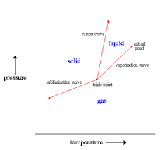
ENGINEERING CHEMISTRY
Module 3- Phase equilibria
A
R
E
A
High pressure, low temperature: solid phase
High temperature, low pressure : vapour phase
In between : liquid phase
solid ⇌ liquid
liquid ⇌ vapour
vapour ⇌ solid
Solid ⇌ liquid ⇌ vapour
LINE
POINT
Source:http://abyss.uoregon.edu/~js/glossary/triple_point.html

Slide 10
THANK YOU
Asha A
Department of Science and Humanities

